Slide 1
CMSC424: Database Design Introduction/Overview
Instructor: Amol Deshpande
amol@cs.umd.edu

Slide 2
Today
Motivation: Why study databases ? What is databases ?
Administrivia
Workload etc.
Current Industry Outlook
A typical DBMS at a glance
No laptop use allowed in the class !!

Slide 3
Some To-Dos
Sign up for Piazza !
Set up the computing environment (project0), and make sure you can run Vagrant+VirtualBox, PostgreSQL, IPython, etc.
Upcoming: Reading Homework 1, Project 1: SQL

Slide 4
Motivation: Data Overload
Explosion of data, in pretty much every domain
Sensing devices and sensor networks that can monitor everything 24/7 from temperature to pollution to vital signs
Increasingly sophisticated smart phones
Internet, social networks makes it easy to publish data
Scientific experiments and simulations produce astronomical volumes of data
Internet of Things
Dataification: taking all aspects of life and turning them into data (e.g., what you like/enjoy turned into a stream of your "likes”)
How to handle that data? How to extract interesting actionable insights and scientific knowledge?
Data volumes expected to get much worse

Slide 5
Four V’s of Big Data
Increasing data Volumes
Scientific data: 1.5GB/genome -- can be sequenced in .5 hrs; LHC generates 100TB of data a day
500M tweets per day (as of 2013)
As of 2012: 2.5 Exabytes of data created every day
EBay: Two data warehouses with 7.5PB and 40PB
Walmart: 583 terabytes of sales and inventory data
FICO monitors 2.5 billion active accounts worldwide
Variety:
Structured data, spreadsheets, photos, videos, natural text, ...
Velocity
Veracity

Slide 6
Four V’s of Big Data
Increasing data Volumes
Variety
Velocity
Sensors everywhere -- can generate tremendous volumes of "data streams"
Real-time analytics requires data to be consumed as fast as it is generated
Veracity
How do you decide what to trust? How to remove noise? How to fill in missing values?

Slide 7
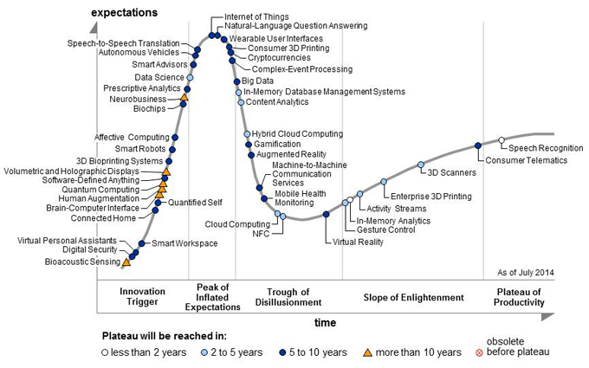
Big Data and Data Science to the Rescue
Terms increasingly used synonymously: also data analytics, data mining, business intelligence
Loosely used for any process where interesting things are inferred from data
Google search: “How Big Data Will Change”
Data scientist called the sexiest job of the 21st century
The term has becoming very muddled at this point
Overhyped words
We are headed toward the
trough of Disillusionment

Slide 8
Is it all hype?
No: Extracting insights and knowledge from data very important, and will continue to increase in importance
Big data techniques are revolutionizing things in many domains like Education, Food Supply, Disease Epidemics, ...
But: it is not much different from what we, especially statisticians, have been doing for many years
What is different?
Much more data is digitally available than was before
Inexpensive computing + Cloud + Easy-to-use programming frameworks = Much easier to analyze it
Often: large-scale data + simple algorithms > small data + complex algorithms
Changes how you do analysis dramatically

Slide 9
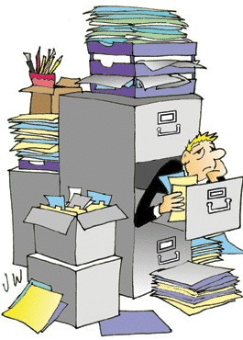
Motivation: Data Overload
How do we do anything with this data?
Where and how do we store it ?
Disks are doubling every 18 months or so -- not enough
In many cases, the data is not actually recorded as it is; summarized first
What if the disks crash ?
Very common, especially with 10,000’s of disks
How do we ensure “correctness” ?
What if the system crashes in the middle of an ATM transaction ?
Can’t have money disappearing
What happens when a million people try to buy tickets to <your favorite artist>’s concert at the same time ?

Slide 10
Motivation: Data Overload
What to do with the data ? How to process/analyze it ?
text search ?
Very limited
“find the stores with the maximum increase in sales in last month”
We can’t expect the users to write Java programs
“how much time from here to Pittsburgh if I start at 2pm ?”
Data is there; more will be soon (GPS, live traffic data)
Requires predictive capabilities
Increasing need to convert “information” to “knowledge”: Data mining
“How many DVDs should we order?” (Netflix)
Find videos with this type of an event (say car break-ins)
Mine the “blogs” to detect “buzz”

Slide 11
Motivation: Data Overload
Speed !!
With TB’s of data, just finding something (even if you know what), is not easy
Reading a file with TB of data can take hours
Imagine a bank and millions of ATMs
How much time does it take you to do a withdrawal ?
The data is not local
How do we guarantee the data will be there 10 years from now ?
Privacy and security !!!
Every other day we see some database leaked on the web
How to make sure different users’ data is protected from each other

Slide 12
Why not use file systems ?
Drawbacks of using file systems to store data:
Data redundancy and inconsistency
Multiple file formats, duplication of information in different files
Difficulty in accessing data
Need to write a new program to carry out each new task
Data isolation — multiple files and formats
Integrity problems
Integrity constraints (e.g., account balance > 0) become “buried” in program code rather than being stated explicitly
Hard to add new constraints or change existing ones

Slide 13
Why not use file systems ?
Drawbacks of using file systems to store data:
Atomicity of updates
Failures may leave database in an inconsistent state with partial updates carried out
Example: Transfer of funds from one account to another should either complete or not happen at all
Concurrent access by multiple users
Concurrent access needed for performance
Uncontrolled concurrent accesses can lead to inconsistencies
Example: Two people reading a balance (say 100) and updating it by withdrawing money (say 50 each) at the same time
Security problems
Hard to provide user access to some, but not all, data

Slide 14
Today
Motivation: Why study databases ? What is databases ?
Administrivia
Workload etc.
Current Industry Outlook
A typical DBMS at a glance
No laptop use allowed in the class !!

Slide 15
Today
Motivation: Why study databases ? What is databases ?
Key Concept: Data Modeling
Key Concept: Data Abstraction
Database Design
Administrivia
Workload etc.
Current Industry Outlook
A typical DBMS at a glance
No laptop use allowed in the class !!

Slide 16
DBMSs to the Rescue
Provide a systematic way to answer many of these questions…
Aim is to allow easy management of high volumes of data
Storing , Updating, Querying, Analyzing ….
What is a Database ?
A large, integrated collection of (mostly structured) data
Typically models and captures information about a real-world enterprise
Entities (e.g. courses, students)
Relationships (e.g. John is taking CMSC 424)
Usually also contains:
Knowledge of constraints on the data (e.g. course capacities)
Business logic (e.g. pre-requisite rules)
Encoded as part of the data model (preferable) or through external programs

Slide 17
DBMSs to the Rescue
Massively successful for highly structured data
Why ? Structure in the data (if any) can be exploited for ease of use and efficiency
If there is no structure in the data, hard to do much
Contrast managing emails vs managing photos
Much of the data we need to deal with is highly structured
Some data is semi-structured
E.g.: Resumes, Webpages, Blogs etc.
Some has complicated structure
E.g.: Social networks
Some has no structure
E.g.: Text data, Video/Image data etc.

Slide 18
Structured vs Unstructured Data
A lot of the data we encounter is structured
Some have very simple structures
E.g. Data that can be represented in tabular forms
Significantly easier to deal with
We will focus on such data for much of the class
Account
bname | acct_no | balance
Downtown Mianus Perry R.H | A-101 A-215 A-102 A-305 | 500 700 400 350
Customer
cname | cstreet | ccity
Jones Smith Hayes Curry Lindsay | Main North Main North Park | Harrison Rye Harrison Rye Pittsfield

Slide 19
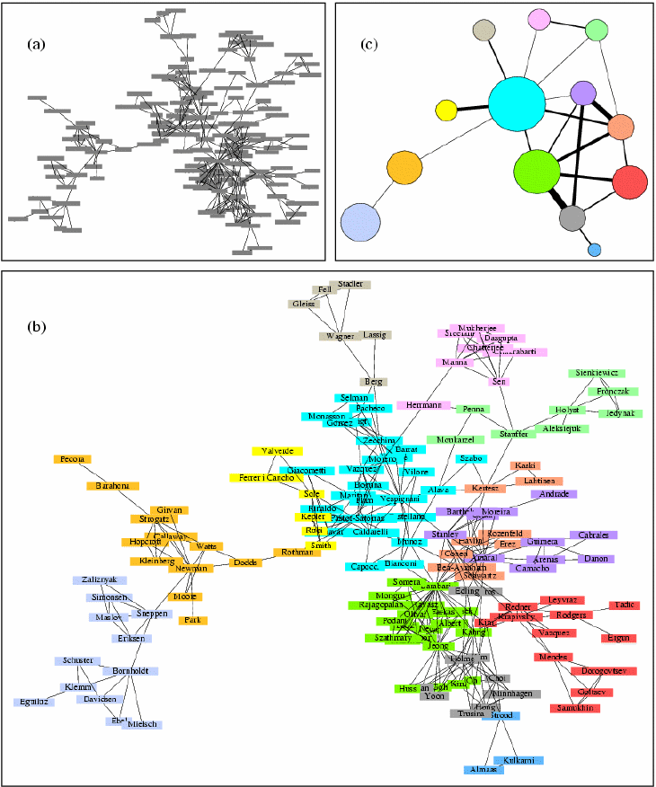
Structured vs Unstructured Data
Some data has a little more complicated structure
E.g graph structures
Map data, social networks data, the web link structure etc
Can convert to tabular forms for storage, but may not be optimal
Queries often reason about graph structure
Find my “Erdos number”
Suggest friends based on current friends
Growing importance in recent years in a variety of domains: Biological, social networks, web…

Slide 20
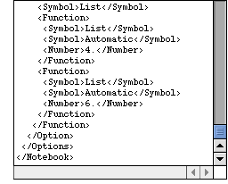
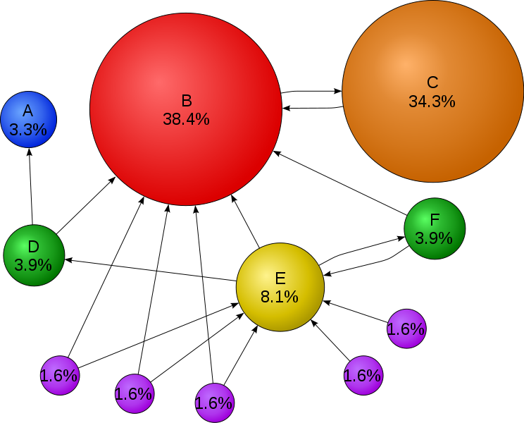
Structured vs Unstructured Data
Increasing amount of data in a semi-structured format
XML – Self-describing tags (HTML ?)
Complicates a lot of things
We will discuss this toward the end
A huge amount of data is unfortunately unstructured
Books, WWW
Amenable to pretty much only text search… so far
Information Retreival research deals with this topic
What about Google search ?
Google search is mainly successful because it uses the structure (in its original incarnation)
Video ? Music ?
Can represent in DBMS’s, but can’t really operate on them
circle size == page importance == pagerank
more incoming links → higher pagerank
incoming links from important pages → higher pagerank

Slide 21
DBMSs to the Rescue
Massively successful for highly structured data
Why ? Structure in the data (if any) can be exploited for ease of use and efficiency
How ?
Two Key Concepts:
Data Modeling: Allows reasoning about the data at a high level
e.g. “emails” have “sender”, “receiver”, “…”
Once we can describe the data, we can start “querying” it
Data Abstraction/Independence:
Layer the system so that the users/applications are insulated from the low-level details

Slide 22
DBMSs to the Rescue: Data Modeling
Data modeling
Data model: A collection of concepts that describes how data is represented and accessed
Schema: A description of a specific collection of data, using a given data model
Some examples of data models that we will see
Relational, Entity-relationship model, XML. JSON…
Object-oriented, object-relational, semantic data model, RDF…
Why so many models ?
Tension between descriptive power and ease of use/efficiency
More powerful models → more data can be represented
More powerful models → harder to use, to query, and less efficient

Slide 23
DBMSs to the Rescue: Data Abstraction
Probably the most important purpose of a DBMS
Goal: Hiding low-level details from the users of the system
Alternatively: the principle that
applications and users should be insulated from how data is structured and stored
Also called data independence
Through use of logical abstractions

Slide 24
Data Abstraction
View Level
What data users and application programs see ?
…
View 1
View 2
View n
Logical
Level
What data is stored ?
describe data properties such as
data semantics, data relationships
How data is actually stored ?
e.g. are we using disks ? Which
file system ?
Physical
Level

Slide 25
Data Abstraction
View Level
…
View 1
View 2
View n
Logical Data Independence
Protection from logical changes
to the schema
Logical
Level
Physical Data Independence
Protection from changes to the
physical structure of the data
Physical
Level

Slide 26
Data Abstractions: Example
A View Schema
course_info(#registered,…)
View Level
…
View 1
View 2
View n
Logical Schema
students(sid, name, major, …)
courses(cid, name, …)
enrolled(sid, cid, …)
Logical
Level
Physical Schema
all students in one file ordered by sid
courses split into multiple files by colleges
Physical
Level

Slide 27
What about a Database System ?
A DBMS is a software system designed to store, manage, facilitate access to databases
Provides:
Data Definition Language (DDL)
For defining and modifying the schemas
Data Manipulation Language (DML)
For retrieving, modifying, analyzing the data itself
Guarantees about correctness in presence of failures and concurrency, data semantics etc.
Common use patterns
Handling transactions (e.g. ATM Transactions, flight reservations)
Archival (storing historical data)
Analytics (e.g. identifying trends, Data Mining)

Slide 28
Relational DBMS: SQL
SQL (sequel): Structured Query Language
Data definition (DDL)
create table instructor ( ID char(5), name varchar(20), dept_name varchar(20), salary numeric(8,2))
Data manipulation (DML)
Example: Find the name of the instructor with ID 22222 select name from instructor where instructor.ID = ‘22222’

Slide 29
Current Industry Outlook
Relational DBMSs
Oracle, IBM DB2, Microsoft SQL Server, Sybase
Open source alternatives
MySQL, PostgreSQL, SQLite (primarily embedded), Apache Derby, BerkeleyDB (mainly a storage engine – no SQL), neo4j (graph data) …
Data Warehousing Solutions
Geared towards very large volumes of data and on analyzing them
Long list: Teradata, Oracle Exadata, Netezza (based on FPGAs), Aster Data (founded 2005), Vertica (column-based), Kickfire, Xtremedata (released 2009), Sybase IQ, Greenplum (eBay, Fox Networks use them)
Usually sell package/services and charge per TB of managed data
Many (especially recent ones) start with MySQL or PostgreSQL and make them parallel/faster etc..

Slide 30
Web Scale Data Management, Analysis
Ongoing debate/issue
Cloud computing seems to eschew DBMSs in favor of homegrown solutions
E.g. Google, Facebook, Amazon etc…
MapReduce: A paradigm for large-scale data analysis
Hadoop: An open source implementation
Apache Spark: a better open source implementation
Why ?
DBMSs can’t scale to the needs, not fault-tolerant enough
These apps don’t need things like transactions, that complicate DBMSs (???)
Mapreduce favors Unix-style programming, doesn’t require SQL
Try writing SVMs or decision trees in SQL
Cost
Companies like Teradata may charge $100,000 per TB of data managed

Slide 31
Current Industry Outlook
Bigtable-like
Called “key-value stores”
Think highly distributed hash tables
Allow some transactional capabilities – still evolving area
PNUTS (Yahoo), Apache Cassandra (Facebook), Dynamo (Amazon), and many many others
Mapreduce-like
Hadoop (open source), Pig (@Yahoo), Dryad (@Microsoft), Spark
Amazon EC2 Framework
Not really a database – but increasing declarative SQL-like capabilities are being added (e.g. HIVE at Facebook)
Much ongoing research in industry and academia

Slide 32
DBMS at a glance
Data Models
Conceptual representation of the data
Data Retrieval
How to ask questions of the database
How to answer those questions
Data Storage
How/where to store data, how to access it
Data Integrity
Manage crashes, concurrency
Manage semantic inconsistencies
Not fully disjoint categorization !!

Slide 33
What we will cover…
We will mainly discuss structured data
That can be represented in tabular forms (called Relational data)
We will spend some time on XML
We will also spend some time on Mapreduce-like stuff
Still the biggest and most important business (?)
Well defined problem with really good solutions that work
Contrast XQuery for XML vs SQL for relational
Solid technological foundations
Many of the basic techniques however are directly applicable
E.g. reliable data storage etc.
Cf. Many recent attempts to add SQL-like capabilities, transactions to Mapreduce and related technologies
E.g., Spark DataFrames

Slide 34
What we will cover…
representing information
data modeling
semantic constraints
languages and systems for querying data
complex queries & query semantics
over massive data sets
concurrency control for data manipulation
ensuring transactional semantics
reliable data storage
maintain data semantics even if you pull the plug
fault tolerance

Slide 35
What we will cover…
representing information
data modeling: relational models, E/R models, XML/JSON
semantic constraints: integrity constraints, triggers
languages and systems for querying data
complex queries & query semantics: SQL
over massive data sets: indexes, query processing, optimization, parallelization/cluster processing, streaming
concurrency control for data manipulation
ensuring transactional semantics: ACID properties, distributed consistency
reliable data storage
maintain data semantics even if you pull the plug: durability
fault tolerance: RAID

Slide 36
Summary
Why study databases ?
Shift from computation to information
Always true in corporate domains
Increasing true for personal and scientific domains
Need has exploded in recent years
Data is growing at a very fast rate
Solving the data management problems is going to be a key
Database Management Systems provide
Data abstraction: Key in evolving systems
Guarantees about data integrity
In presence of concurrent access, failures…
Speed !!

Slide 37
Logistics
Instructor: Amol Deshpande
3221 AV Williams Bldg
amol@cs.umd.edu
Class Webpage:
Off of http://www.cs.umd.edu/~amol,
Or http://www.cs.umd.edu/class
Or through ELMS
Email to me: write CMSC424 in the title
Piazza (public or private messages) much preferred
TAs: Souvik Bhattacharjee, Hui Miao, Parth Desai

Slide 38
Logistics
Textbook:
Database System Concepts
Sixth Edition
Abraham Silberschatz, Henry F. Korth, S. Sudarshan
Lecture notes will be posted on the webpage
Piazza
We will use this in place of a newsgroup
First resort for any questions
General announcements will be posted there
Register today !

Slide 39
Administrivia Break
Workload:
6 (individual) programming projects (30%)
10 late days in total, no more than 4 for any project
2 midterms (25%), Final (25%)
Reading homeworks (12%)
One every week (can get full credit with 12/14)
Assigned reading, simple questions on the reading (to ensure you read it) and homework on the previous week’s material
Readings will refer to the Sixth edition of the book
Expect to spend about 1.5-2 hours on each
With the exception of the ones for the cancelled classes
Class participation (7%)
May do in-class activities later
Meet the instructor (1%)

Slide 40
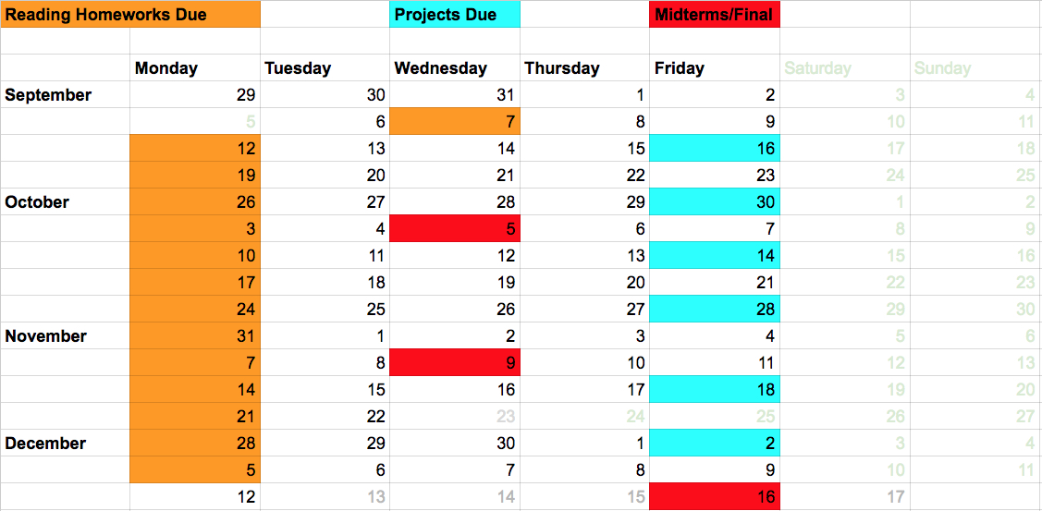
Logistics
Project 1: SQL (out by tomorrow)
May want to get started on this soon since it covers the same stuff as the first reading homework

Slide 41
Logistics
Grading
Approximate cut-offs
80+: A
70+: B
60+: C
60-: D/F
Most had 40+ on non-exams last two times (out of 50)
Exams are usually somewhat harder (no curves)
We would enforce a minimum passing grade on the total exam score

Slide 42
Some To-Dos
Sign up for Piazza !
Set up the computing environment (project0), and make sure you can run Vagrant+VirtualBox, PostgreSQL, IPython, etc.
Upcoming: Reading Homework 1 (Due next Wednesday), Project 1: SQL (Sept 16)

